Slide 1
A practical guide to meta-analysis

Slide 2
Lab agenda
Today:
Why meta-analysis?
What is meta-analysis?
How to do a meta-analysis?
Analyzing meta-analytic data
Synthesizing practical and scientific evidence: a practical view

Slide 3
Evidence-based management?
Notes:
2007. Management (3772), Business (3218), Applied Psych (2168).
2017. Management (9549), Business (7265), Applied Psych (3714).

Slide 4
Evidence-based management!
“Evidence-based management means translating principles based on best evidence into organizational practices” (Rousseau, 2006, p. 256)
“In a world afflicted by complex problems, we should have more assurance that managers will also draw on knowledge greater than their own” (Pfeffer, 2011, p. 38)
Notes:
2007. Management (3772), Business (3218), Applied Psych (2168).
2017. Management (9549), Business (7265), Applied Psych (3714).

Slide 5
Evidence-based management!
Applying ‘big evidence’ using knowledge of ‘little evidence’ (Rousseau, 2006)
Little evidence: local knowledge of the ‘problem’
Big evidence: scientific evidence
First step: gather all the evidence!
Notes:
2007. Management (3772), Business (3218), Applied Psych (2168).
2017. Management (9549), Business (7265), Applied Psych (3714).

Slide 6
How to summarize the results?
Traditionally:
narrative literature reviews
vote counting method
Now:
systematic reviews + meta‐analysis

Slide 7
What is meta-analysis?
Synthesis-generated evidence
‘Statistical summary’ of the relationship between two variables
Why do a meta-analysis?
Summarize evidence on a particular relationship
Assess robustness of particular effect over multiple studies
Explore and test boundary conditions/moderators of that relationship
Key to translate ‘big evidence’ into ‘small evidence’

Slide 8
Meta-analytic data: study-level data!
Meta-analytic data = study-level data
Effect sizes between two variables.
Today: correlations
Study-level content data: sample size, country, industry, type of team, etc. etc. etc.

Slide 9
Coding procedures
Assumption: you have found all the relevant articles
Coding scheme: decision tree for all variables to be coded
Must (!) be exclusive; a variable must fit your current scheme (or you must update it)
Craft your coding scheme based on pilot coding; update as you go along, but fix solutions ex ante as much as possible
Code:
Effect size
Sample size
Study-level data

Slide 10
Let’s get statistical!

Slide 11
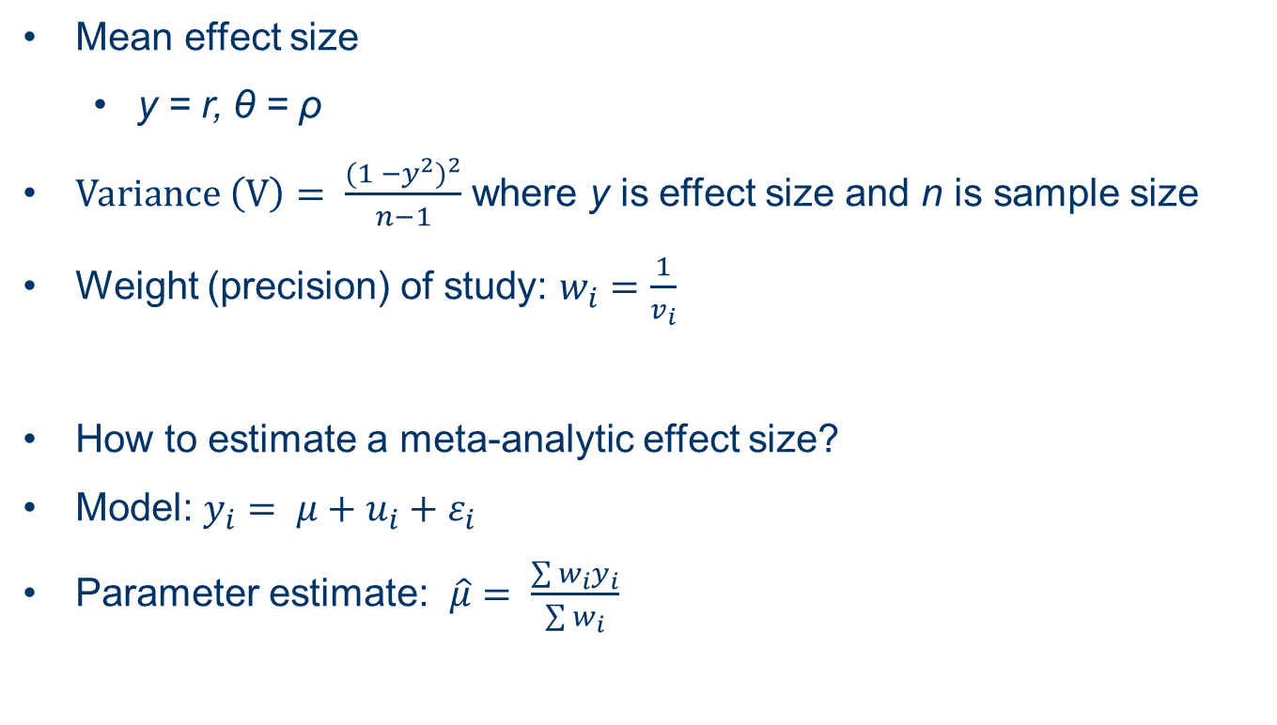
Analysis time: some formula’s for correlational meta-analysis
Mean effect size
y = r, θ = ρ
$Variance \left(V\right)= \frac{{(1 −y^{2})}^{2}}{n−1}$ where y is effect size and n is sample size
Weight (precision) of study: $w_{i}=\frac{1}{v_{i}}$
How to estimate a meta-analytic effect size?
Model: $y_{i}= μ+u_{i}+ε_{i}$
Parameter estimate: $\hat{μ}= \frac{\sum{w_{i}y_{i}}}{\sum{w_{i}}}$

Slide 12
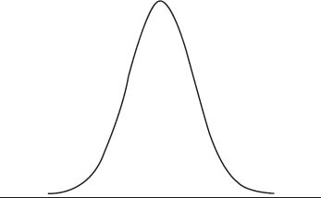

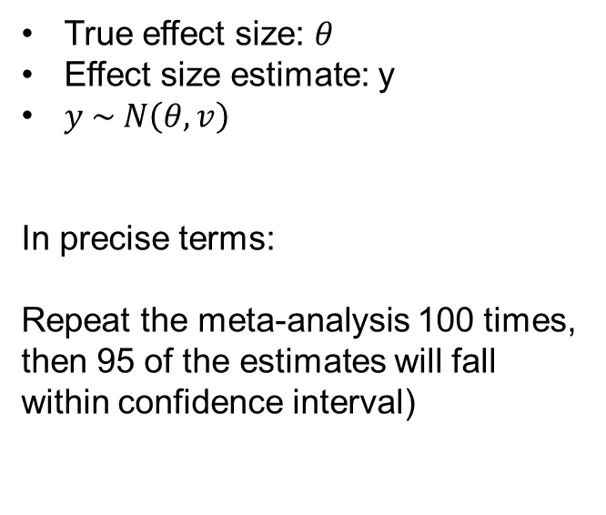


Sampling variability
True effect size: $θ$
Effect size estimate: y
$y \sim N\left(θ,v\right)$
In precise terms:
Repeat the meta-analysis 100 times, then 95 of the estimates will fall within confidence interval)
$$θ$$
95%
$$θ−1.96\sqrt{v}$$
$$θ+1.96\sqrt{v}$$
Partially adapted from Viechtbauer (2016)

Slide 13
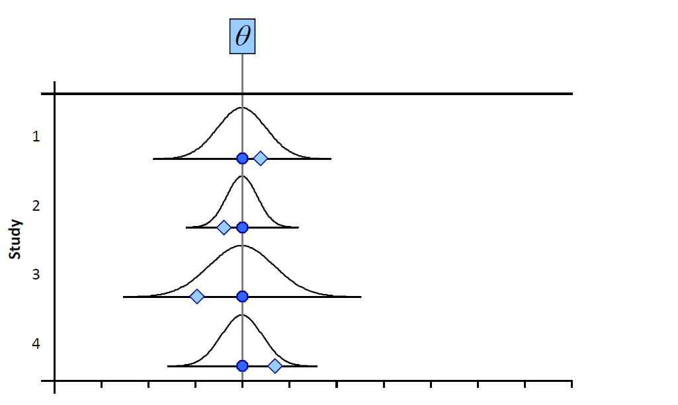
Fixed effects (it depends does not apply)
Partially adapted from Viechtbauer (2016)

Slide 14
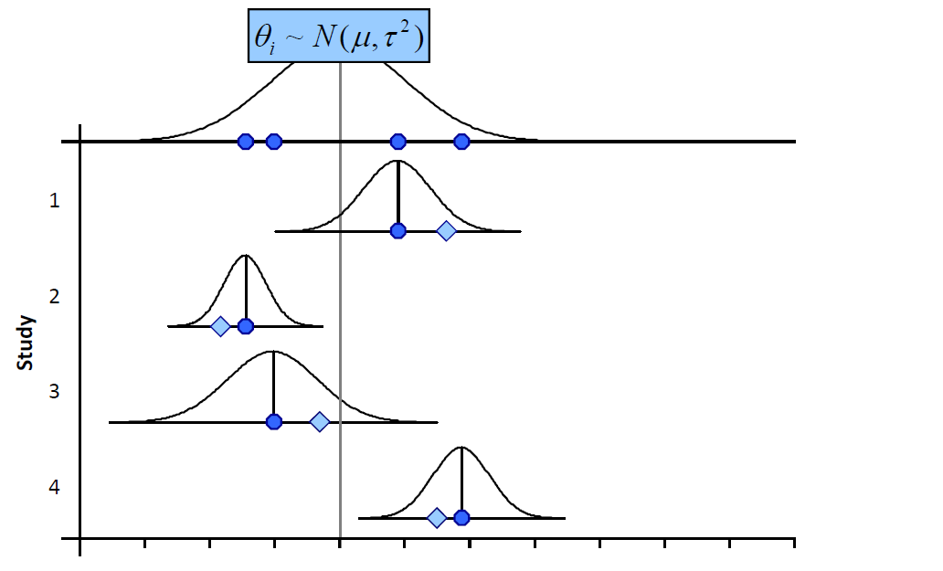


Random-effects (it depends applies)
$$y (estimated ES)$$
$$θ=(true ES)$$
Partially adapted from Viechtbauer (2016)

Slide 15
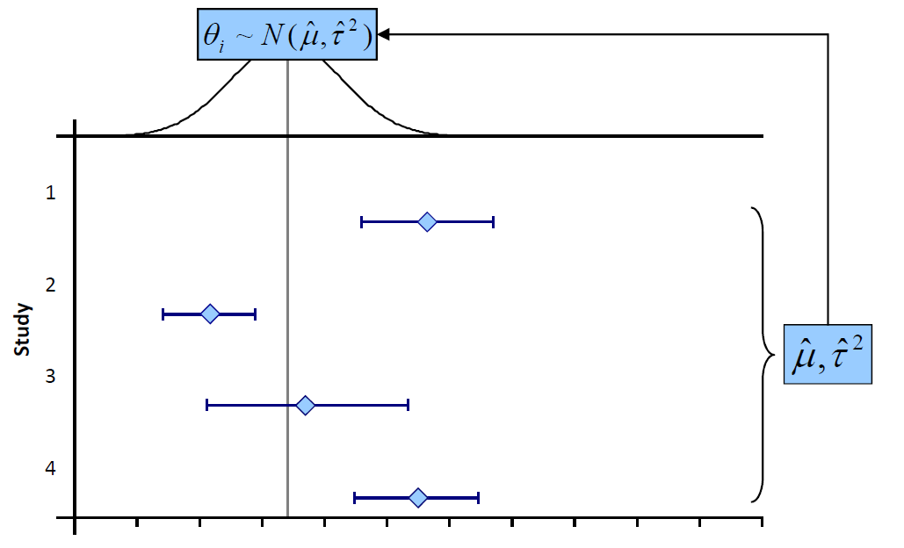
Random-effects model
Partially adapted from Viechtbauer (2016)

Slide 16
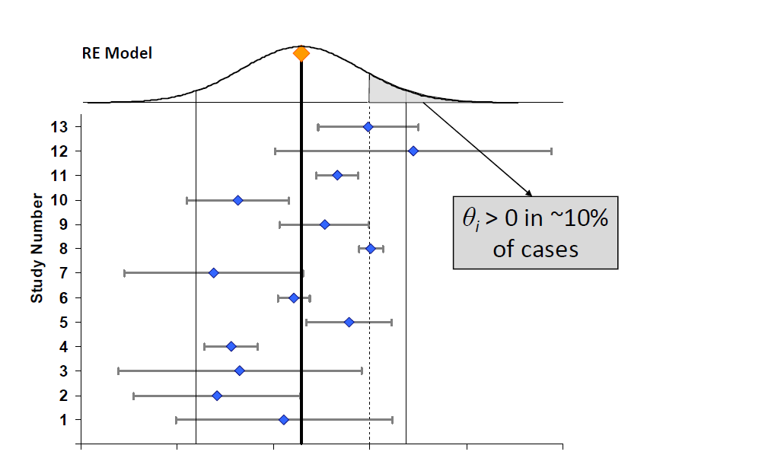


Random effects
$$θ \sim N(−0.07, 0.06)$$
-0.3 -0.2 -0.1 0 0.1
$$μ=−0.07$$

Slide 17
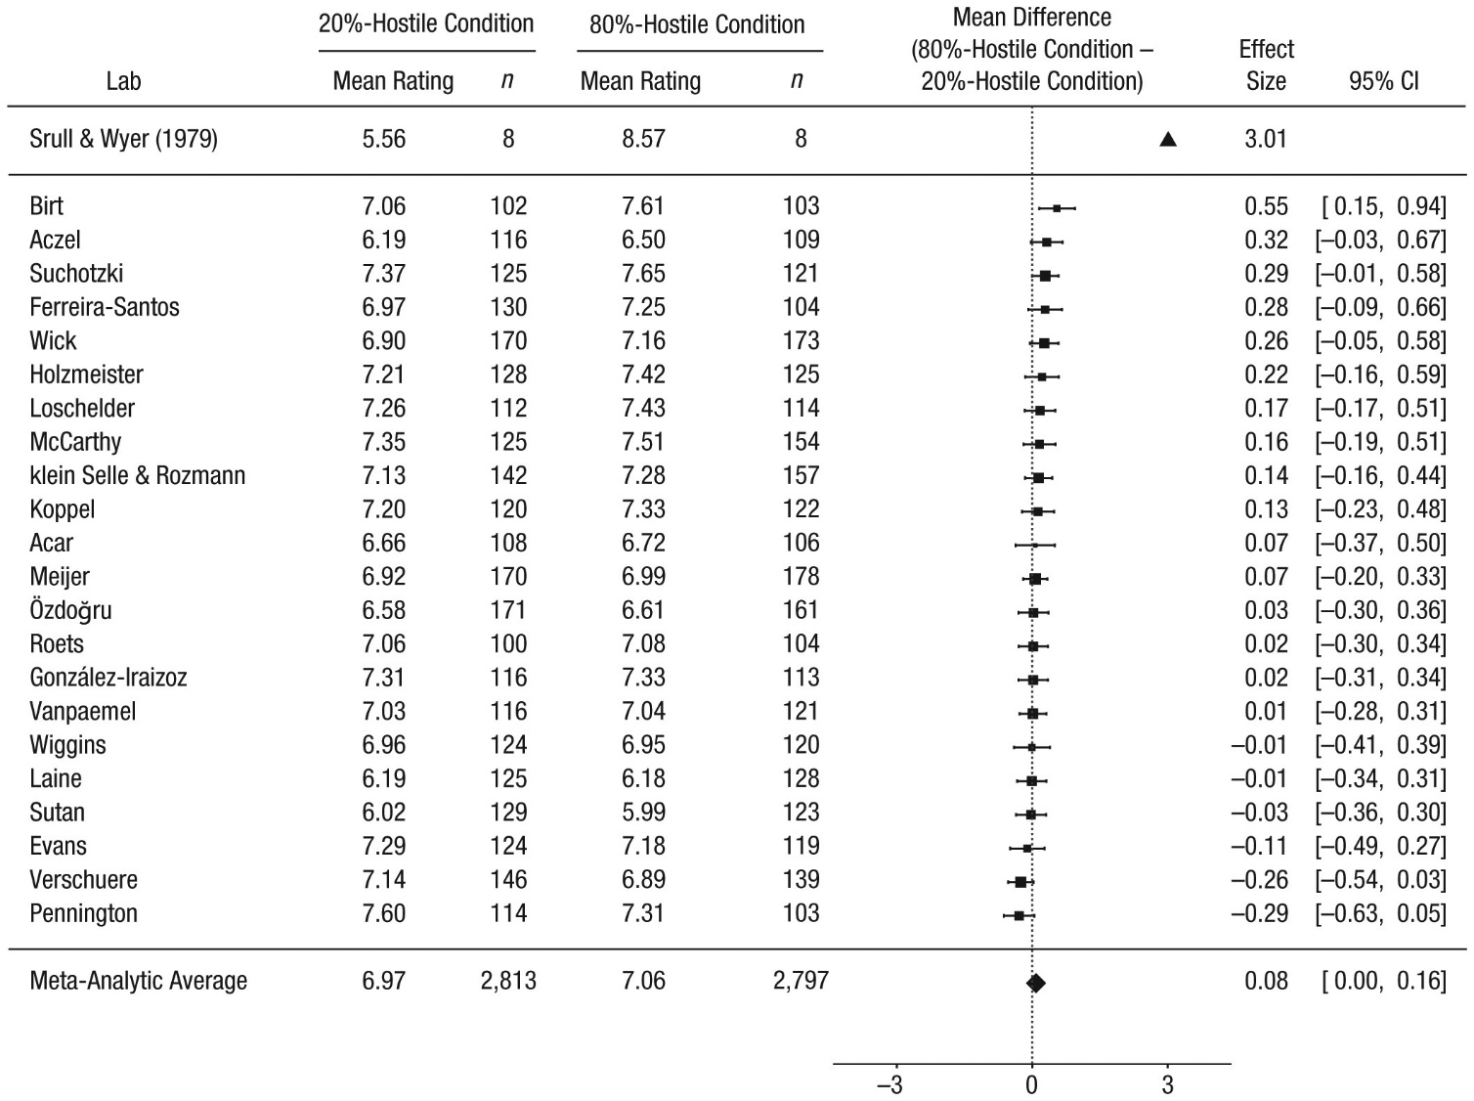

Slide 18
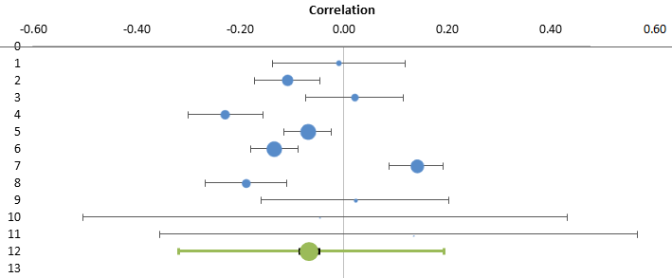
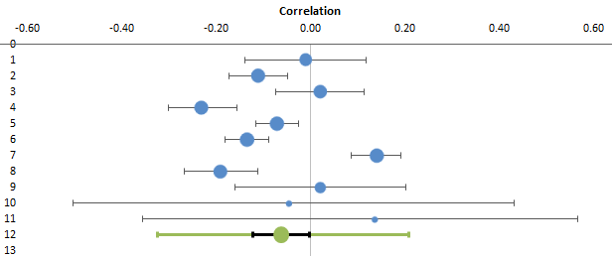


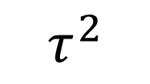
Various variances..
$$τ^{2}$$
Fixed
effects
$$ε_{i}$$
Random effects
$$τ^{2}$$

Slide 19
Analysis time using Meta-Essentials: Correlational data
Study name | Include study | Correlation | Number of subjects | Sufficient data | Subgroup | Moderator
aaaa | Yes | 0.06 | 50 | Yes | 1 | 10.00
bbbb | Yes | 0.05 | 60 | Yes | 2 | 80.00
cccc | Yes | 0.14 | 80 | Yes | 1 | 65.00
dddd | Yes | -0.01 | 1413 | Yes | 2 | 18.00
eeee | Yes | -0.02 | 1413 | Yes | 2 | 40.00
ffff | Yes | -0.04 | 1413 | Yes | 2 | 7.00
gggg | Yes | 0.02 | 1540 | Yes | 1 | 5.00
hhhh | Yes | -0.13 | 1750 | Yes | 1 | 102.00
iiii | Yes | -0.07 | 1828 | Yes | 1 | 66.00
jjjj | Yes | 0.07 | 2412 | Yes | 2 | 53.00
kkkk | Yes | -0.05 | 2479 | Yes | 2 | 32.00
llll | Yes | -0.02 | 2539 | Yes | 1 | 87.00

Slide 20
Analysis time: Output
Tab: Forest Plot --> Main findings + forest plot (graphical display of meta-analytic result)
Subgroup Analysis: Same, but per subgroup that was used (categorical moderator)
Moderator Analysis: Results using a continuous moderator
Calculations: all raw data calculations based on data in ‘Input’ (inspect this to see any ‘odd’ data entries)

Slide 21
Example of a meta-analysis
Based on: ‘Understanding Heterogeneity in the Performance Feedback - Organizational Responses Relationship: A Meta-Analysis’ (work in progress)
Central claim: performance shortfalls invoke search for and implementation of alternatives
Empirical evidence highly mixed (Posen et al., 2018)
Consolidate and extend performance feedback theory through meta-analysis
Practically important (!):
reflection of why organizations respond to performance informs managers on intertemporal adaptation --> Intervention?
predicting competitor’s moves --> Intervention?
detect sources of inertia --> Intervention?

Slide 22
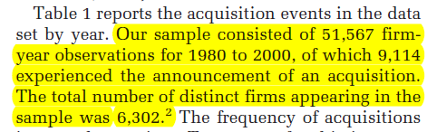
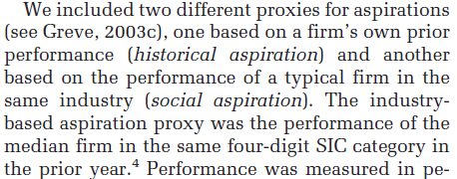
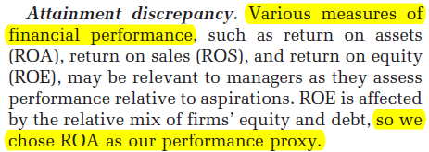
Coding examples Iyer and Miller (2008)
SAMPLE SIZE (P. 812)
ASPIRATIONs (P. 812)
PERFORMANCE METRIC (P. 812)

Slide 23
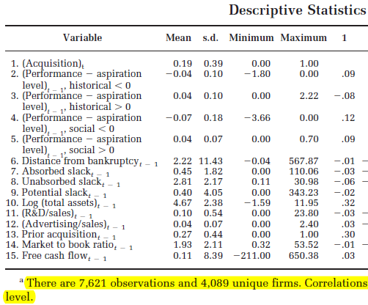
Correlation table Iyer and Miller (2008)

Slide 24
Time for some results
Meta-Essentials: http://bit.ly/ebi-data
Raw data: http://bit.ly/ebi-real-data
Response to performance feedback: R&D intensity
Effect sizes
Correlations of historical and social performance feedback (below and above aspiration)
Moderator coding
Average firm age (continuous),
industry (1 = high-tech, 2 = manufacturing)

Slide 25
Assignment
Interpretation implies: sign of effect, magnitude of effect, statistical significance, implications for practice
Interpret the result of the meta-analysis for historical performance below the aspiration level (‘historical underperformance’)
Hint: look at cell B10 in ‘Forest Plot’ tab and the graph that is produced
Interpret results of subgroup analysis (industry difference) for HP < A
Hint: look at cell F6 and F13 in ‘Subgroup Analysis’ tab to start this exercise
Interpret the result of the moderator analysis (organizational age)
Repeat assignment for SP < A and interpret differences between results for HP < A and SP < A

Slide 26
The end is near
Compulsory reading:
Borenstein, Hedges, Higgins, and Rothstein (2009). Introduction to meta-analysis. Preface + chapter 1, 2, and 40.
Download: http://bit.ly/meta-ebi
Aguinis, Pierce, Bosco, Dalton, and Dalton (2011). Debunking myths and urban legends about meta-analysis. Organizational Research Methods, 14(2), 306-331.

